Slide 1
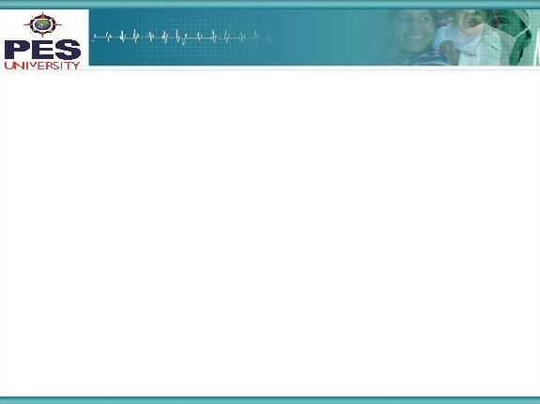



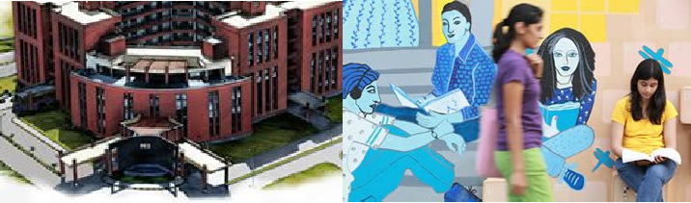

Project Presentation
(Final - ESA)
Topics in Deep Learning
UE17CS338
Project Title: Auto-Encoder with Attention for Neural Machine Translation
Project Team : Vinayaka M Hegde PES1201701600
S Thejas PES1201701621
Ramakrishnan K PES1201701906

Slide 2
Project Abstract and Scope
Conversion of English sentences to French sentences using LSTM autoencoder with additional attention layer
Sequence to sequence translation is a very interesting field and is very useful. We wanted to learn more about it by implementing a model for translation

Slide 3
Project Abstract and Scope
Generally auto encoders are used for this Neural Machine Translation
We made use of attention in addition to autoencoders to study its effects on accuracy of translation
This model could be used for translation of other languages by providing appropriate data for training

Slide 4
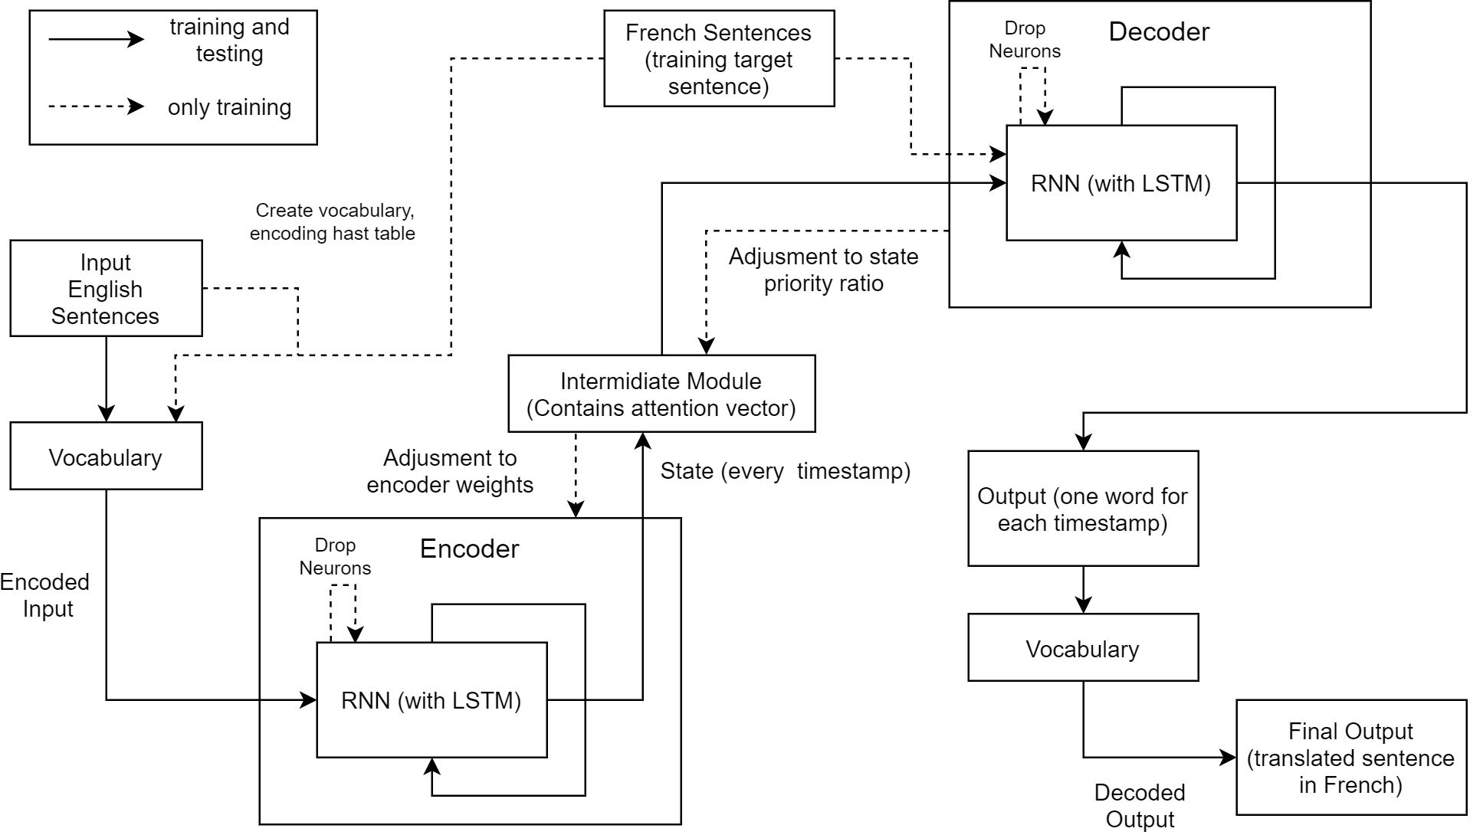
Solution Architecture
‹#›

Slide 5
Algorithm
Pass a sentence to encoder
Process sentence word by word
Maintain encoder state at every timestamp
Pass the all the states of the encoder to the intermediate module
Pass attention vector, states of encoder, translated sentence to decoder
Adjust the weights of decoder, attention vector, weights of encoder based on the passed output (actual translated sentence)
Dropout neurons based on dropout probability
Adam optimiser is used

Slide 6
Math
In the encoder and decoder LSTMs, the hidden state and cell states are computed using:
H_{t} = O_{t} * tanh(C_{t})
C_{t} = C_{t-1} * ft + it * gt
Where,
H_{t} = hidden state
C_{t} = cell state
Ft = forget gate
it, gt = used for write gates

Slide 7
Math
For Bahdanau attention mechanism, attention weights are computed using :
res = tanh ( W_{encoder} * H_{encoder} + W_{decoder} * H_{decoder})
alignment scores = W_{align} * res
attention weights = softmax (alignment scores)
where,
W_{encoder} , W_{decoder} = weights of encoder and decoder
H_{encoder} , H_{decoder} = hidden states of encoder and decoder
W_{align} = weight vector for alignment scores

Slide 8
Testing
The outputs were tested using dataset consisting of english sentences and french sentences
Accuracy of 90% was achieved without dropout
Accuracy of 94% was achieved with dropout
(best keep probability = 0.5)
Accuracy of 97% was achieved with attention and dropout

Slide 9
Criterion for considering it a good solution
High accuracy was achieved during the validation phase
Used google translate to verify the output after testing phase.

Slide 10
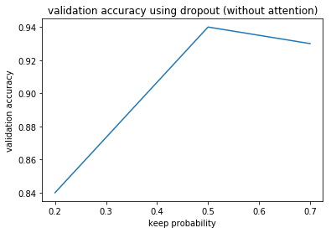
Graph

Slide 11
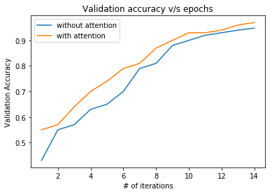
Graph

Slide 12
Constraints, Assumptions & Dependencies
Constraint:
Our model encounters difficulties when faced with rare words or words that are ambiguous as sometimes the model cannot interpret information to the required context.
Assumptions:
The english sentences and the translated french sentences only contain words which was present in the training set
Only ASCII characters are given as input
Dependency:
Tensorflow module version 1.14.0

Slide 13
Future work plan
Test the functionality of the network with other languages
Test the functionality of this architecture for summarisation of text

Slide 14
References
FloydHub Blog. 2020. Attention Mechanism. [online] Available at: <https://blog.floydhub.com/attention-mechanism/> [Accessed 21 April 2020].
TensorFlow. 2020. Introduction To Tensorflow. [online] Available at: <https://www.tensorflow.org/learn> [Accessed 21 April 2020].
Pathmind. 2020. A Beginner's Guide To Attention Mechanisms And Memory Networks. [online] Available at: <https://pathmind.com/wiki/attention-mechanism-memory-network> [Accessed 21 April 2020].
Arxiv.org. 2020. [online] Available at: <https://arxiv.org/pdf/1409.0473.pdf> [Accessed 21 April 2020].
Medium. 2020. Understanding Encoder-Decoder Sequence To Sequence Model. [online] Available at: <https://towardsdatascience.com/understanding-encoder-decoder-sequence-to-sequence-model-679e04af4346> [Accessed 21 April 2020].

Slide 15
Thank You

